Slide 1
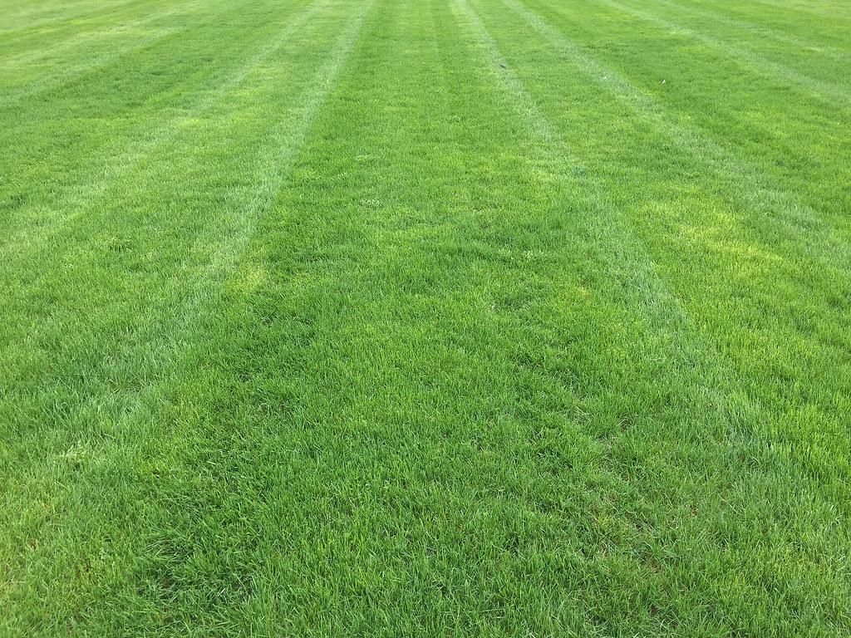
Final Project
Pitch Crazy
Nareg Artinian
Joshua Bradner
Jason Hardman
Roland Teruya
Yan Xu

Slide 2
Agenda
Recap and Update
Final Methodology
Model Performance
Results
Appendix
Notes:
Josh Introduction

Slide 3

Recap and Update from Midterm
Notes:
Josh

Slide 4
High Level Overview
Objective
Develop and validate methodology necessary to automatically determine, with greater than 50% accuracy, how many different types of pitches a pitcher is able to throw.
Pitch classification model requirements
Optimal cluster count
Automated
Provide a better than 50% degree of accuracy in identifying the number of pitch types
Goals
Notes:
Josh: As we progressed in the project we realized that the validation set we used was flawed and open to interpretation, goal was changed to better than a coin flip.

Slide 5
Algorithms Used
We used Partition Around the Medoid (PAM) and Hierarchical Density-Based Spatial Clustering of Applications with Noise (HDBSCAN) for our clustering approach.
PAM
Produces the most consistent results when separating fastballs from non fastballs, this was achieved using the lowest c index score as the PAM selection criteria.
Produces the best results when spliting non-fastballs along the Break_x axis, utilizing PAM(k=2).
HDBSCAN
Since HDBSCAN can identify clusters without needing the K value, it combined well with PAM to help identify clusters and build in logic for the model.
Notes:
Josh: PAM - performed a PAM k=2 & k=3 on the velo axis
Remember to mention the continue clustering and stop clustering decision that will be covered in later slides for fastballs. (Decision based on the shape of the distribution and outliers along each axis.
.

Slide 6
Data Wrangling
Decided against normalization for handedness since it adds no value to the model.
Changed our approach to separate fastballs from non-fastballs.
We were able to achieve >89% accuracy on clustering different fastball pitches.
Splitting out the fastballs allowed the team to take a more measured approach to identify the non-fastball clusters due to our ability to focus on the x-axis movement.
Notes:
Josh - handoff to Jason to Final Methodology

Slide 7
Final Methodology
Notes:
Jason

Slide 8
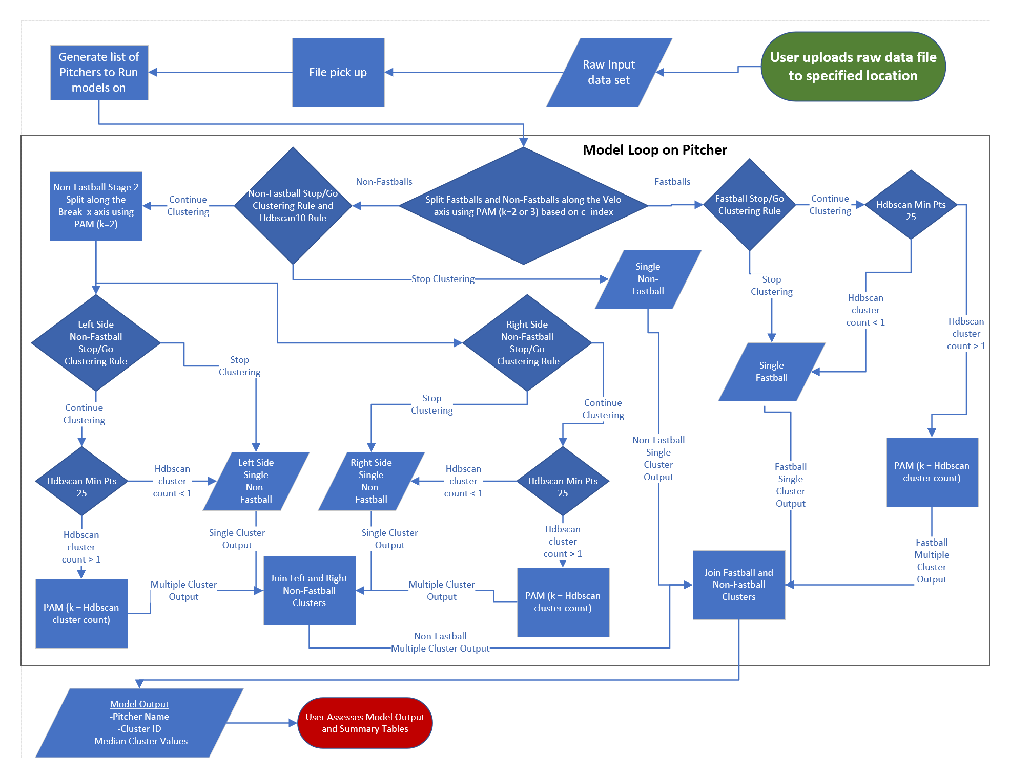
ETL Overview
Load original data set into r script
Split fastball and non fastballs using Pam( k=2 or 3), while looping pitchers into new dataframe
For non fast balls, split along x axis using Pam
For fast balls and non-fast balls, hdbscan to differentiate clusters
Utilized stop/go rules for identifying when to stop or continue clustering
Combine both results into one data frame
Notes:
Jason: From loading the original data set into r script, we split the fastballs and non fastballs using pam. For the non fastballs, we split along the x axis. For both sets we then used hdbscan to separate out the clusters all while using stop and go rules for deciding when to quit clustering. Then we combined the data back into one dataframe.

Slide 9
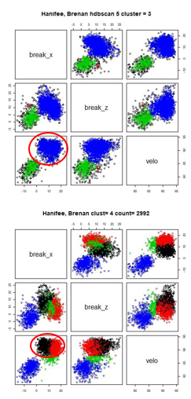
Separation of Fastballs and Non-Fastballs
Problem: Too much Noise to Cluster Accurately
All algorithms have difficulty distinguishing between close or overlapping clusters
Clustering Algorithms have difficulty identifying multiple fastballs, if any existed
Solution: Simplify, Divide, and Conquer
Simplify: PAM clustering along the velo axis only.
Divide: Focus on 2-seam and 4-seam pitches only within newly created fastball pitches while applying different clustering methods to non-fastballs along horizontal and vertical axes
Conquer: Algorithmically defined rules and clustering parameters created and applied for each pitcher individually.
Notes:
Jason : The problem:When we first approached the dataset, we implemented the data directly into clustering algorithms. The results were noisy and could not create distinguishing clusters, in addition to identifying the various single and multiple fastballs. This approach did not produce the needed results to move forward. So we decided to divide and conquer using Pam clustering. This allowed us to focus on the 2 and 4 seams and also allowed for multiple rules and methods to be applied to individual pitchers

Slide 10
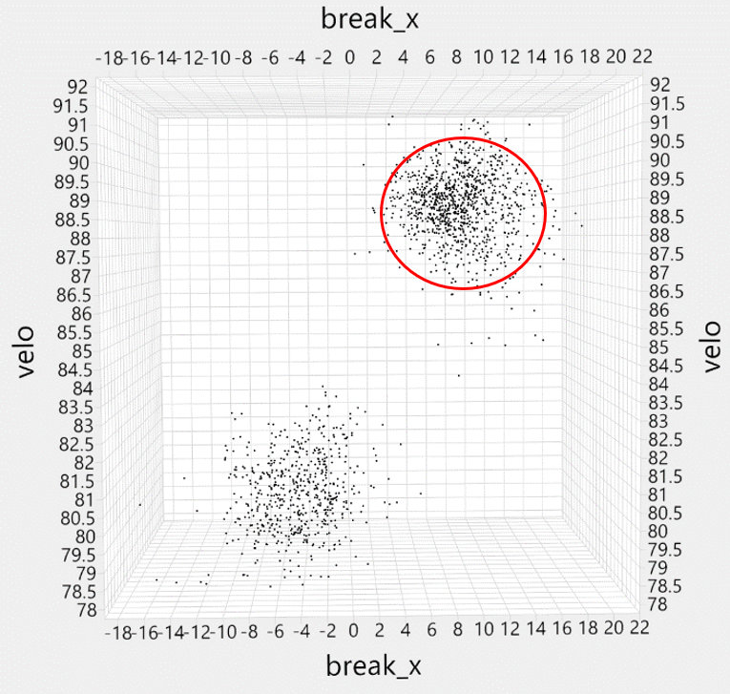
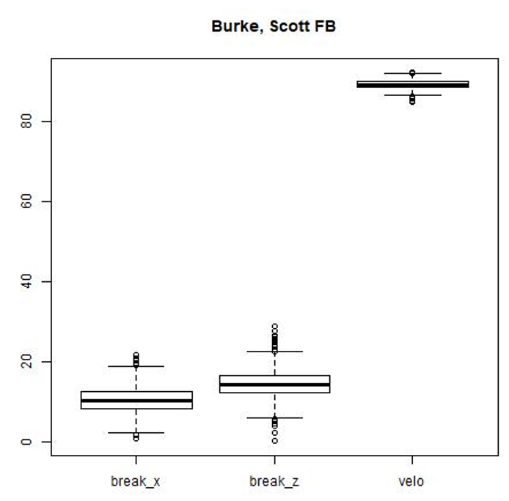
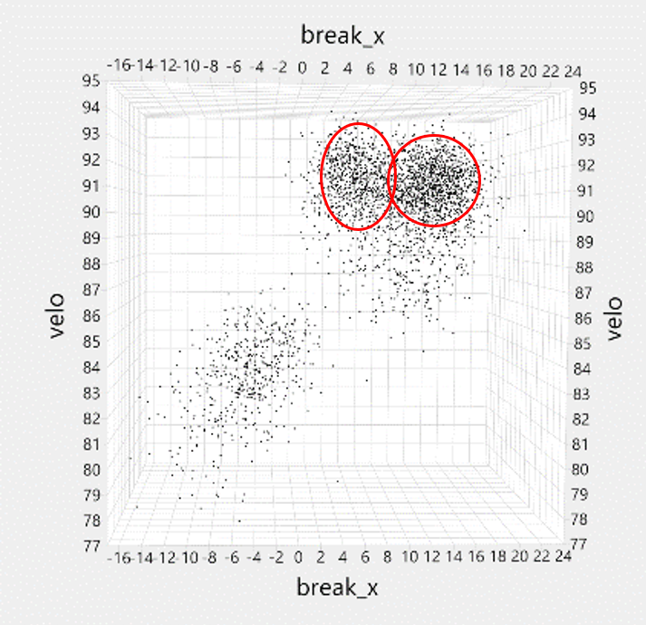
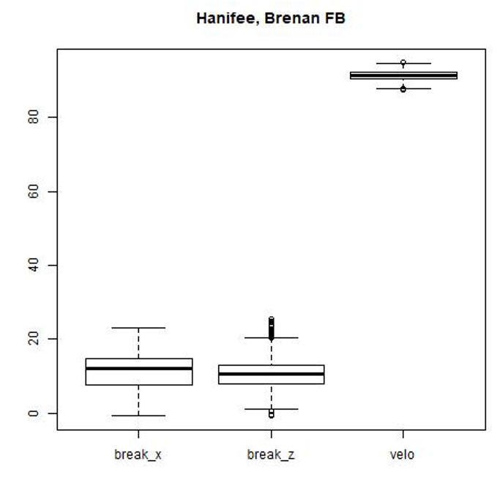
Stop/Go Rules
When we separate pitches, there are situations where a single cluster is left and clustering should stop.
Rules based on the cluster distribution and outliers
Skewed vs. Normal Distributions
Uneven vs. Even Interquartile Ranges
Uneven vs. Even Percentage of Outliers
Combining the Rules with HDbscan further improves the decision process
Notes:
Jason: After separating the pitches and while clustering was taking place, we noticed there was not a cut off for when to stop clustering. We developed stop and go rules that take into account skewed vs normal distributions, uneven vs even interquartile ranges, and uneven vs even percentage outliers. Applying these rules along with hdbscan improved the decision process.

Slide 11
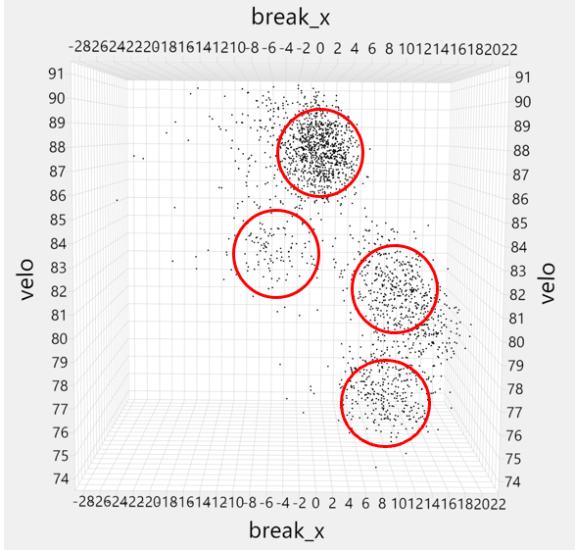
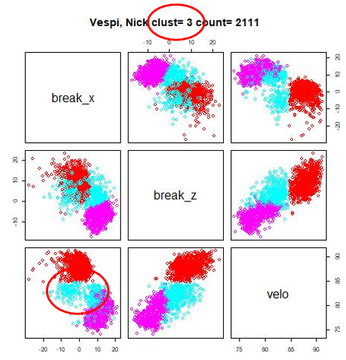
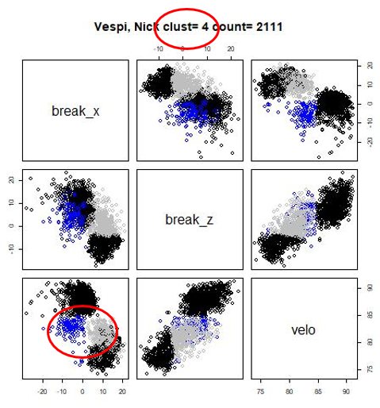
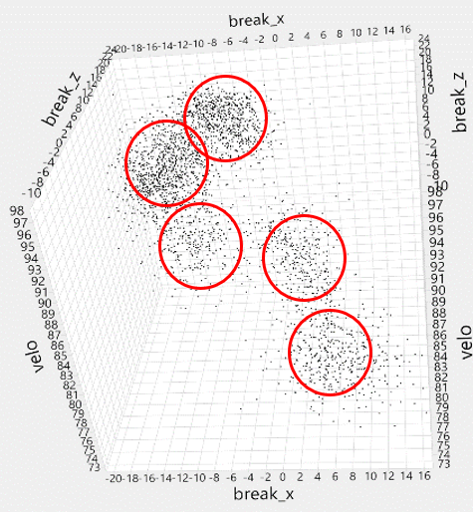
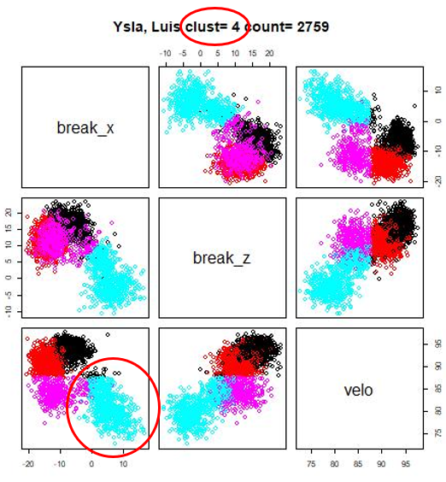
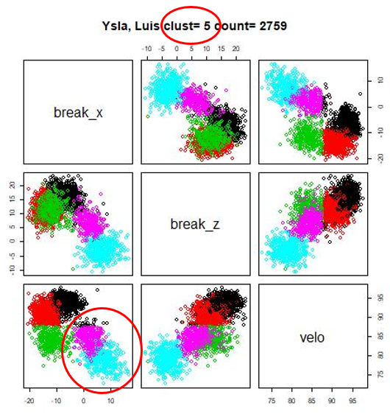
Stage 2 Non-Fastball Clustering
Visual Clustering
Validation
Clustering of Non-Fastball prior to Stage 2
Stage 2 Cluster, split along break_x
Split the Non-Fastballs along the break_x axis only.
Benefits:
Allowed the rules and clustering methods to be applied on smallers sets improving the overall accuracy..
Identified clusters not identified by clustering algorithms alone.
Notes:
Jason - hand off to josh after : After the separation of the fastballs and non fastballs, we moved onto stage 2 for clustering of non fastballs. We decided to split all the non fastballs along the break x axis. By doing this, it allowed the methods to be applied to pitchers with less pitches and improved overall accuracy. Also by splitting the non fastballs along the break x axis, we were able to identify clusters that were not previously identified.

Slide 12
Model Performance and Findings
Notes:
Josh

Slide 13
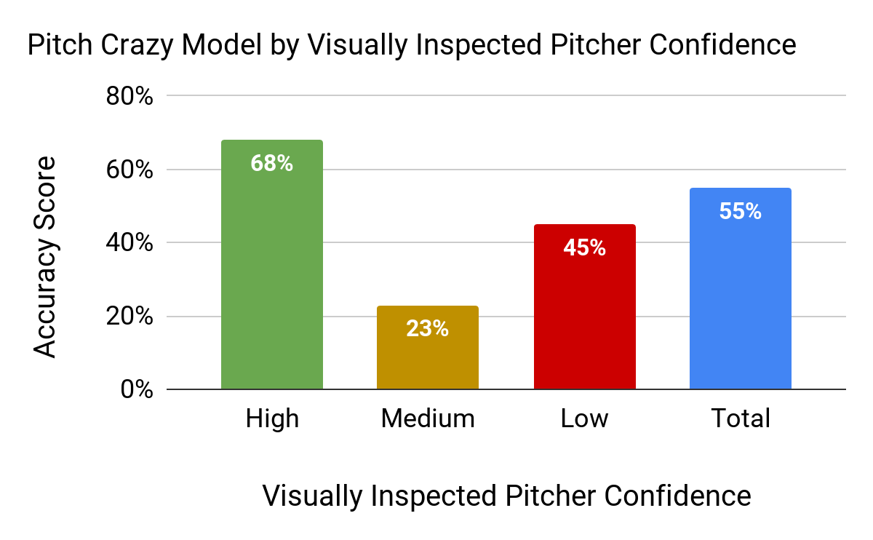
Final Accuracy Score of Pitch Crazy Model
Visually inspected pitcher confidence is defined by the following logic applied to the visual inspection outputs.
High = Professor Coates defined “H” or teams agree or confidence value greater than 5
Medium = Professor Coates defined “M” or confidence value between 5 and 4
Low = Professor Coates defined “L” or confidence value below 4
Notes:
Josh - Pitch Crazy’s overall model accuracy score = 55% By comparing our model to the visually inspected pitchers we were able to achieve 68% accuracy on high, 23% accuracy on medium and 45% accuracy on low with the overall total accuracy coming to 55%

Slide 14
Pitch Crazy Model Strengths and Weaknesses
Strengths
Weaknesses
Model identifies and simplifies complexities inherent in the given problem and structure of data
Excellent at partitioning low cluster count models
Loses accuracy with abnormal shapes
Difficulty with clusters with lower number of records
Early errors could compound on each other
Notes:
Josh

Slide 15
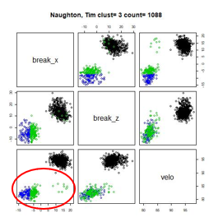
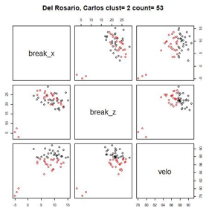
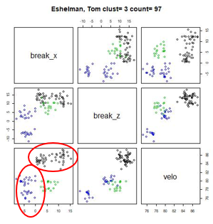
Flag for Human Review
Skew_x, Skew_z, Skew_velo is greater than or equal to 1.5
Total pitch count is less than or equal to 100
Individual cluster count is less than or equal to 50
Notes:
Josh switch to Jason for Project Conclusion
The skewness and individual cluster count is generated in our summary 2 table

Slide 16
Project Conclusions
Notes:
Jason

Slide 17
Conclusions
Separating Fastballs from Non-Fastballs and running a parallel job to cluster both subsets had the highest lift in model performance compared to other methods attempted.
Using PAM in conjunction with HDbscan to separate out the pitches, either fb or non-fb, produced better results.
There was some degree of difficulty identifying a solution to differentiate between multiple types of fastballs, two seam, four seam, etc. thrown by an individual pitcher. It is also hard to differentiate the clusters with the human eye. We were able to use a combination method of a logical rule and Hdbscan to get an accuracy of 89-98% that a pitcher throws multiple types of fastballs.
Although the approach wasn’t used, normalizing the handedness of the pitcher didn’t have a measurable impact on the analysis results.
After Fastball and Non-Fastball splitting, pitches in both categories requires additional logical rules to confirm whether it is a single-split or multi-split in their corresponding category.
Notes:
Jason: In conclusion, a few takeaways are ...

Slide 18
Appendix

Slide 19
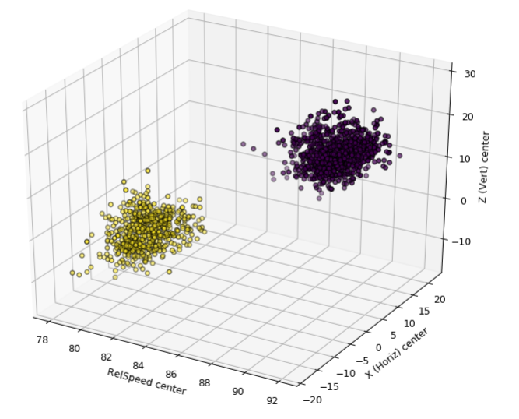
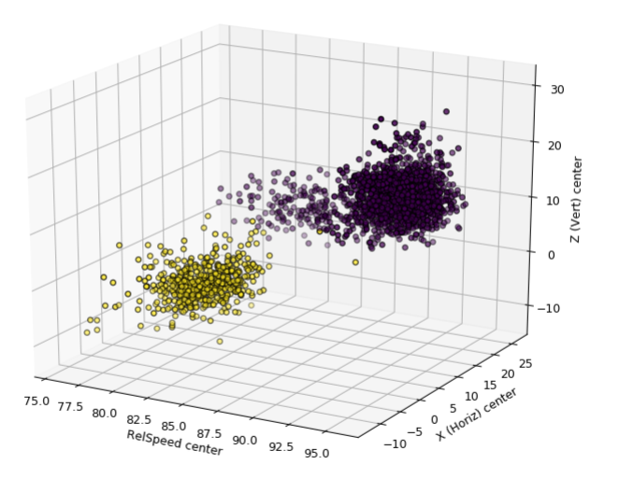
Mean Shift
Algorithm Pros
Algorithm relies on “Basins of Attraction” to identify various maxima, in this case cluster centroids.
Efficient with clustering abnormal shapes (non-ellipsoid)
Highly iterative algorithm, will slow total process time
May misclassify outliers into incorrect clusters rather than treating them as such
Good Clustering
Algorithm Cons
Poor Clustering
Notes:
1.It is a centroid based algorithm, which works by updating candidates for centroids to be the mean of the points within a given region.
2. The algorithm automatically sets the number of clusters, instead of relying on a parameter bandwidth, which dictates the size of the region to search through.

Slide 20
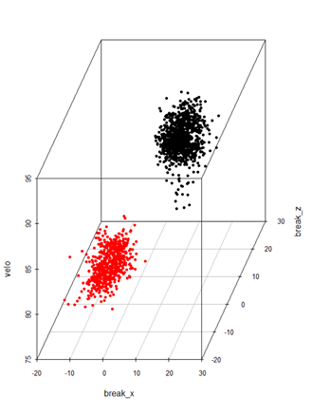
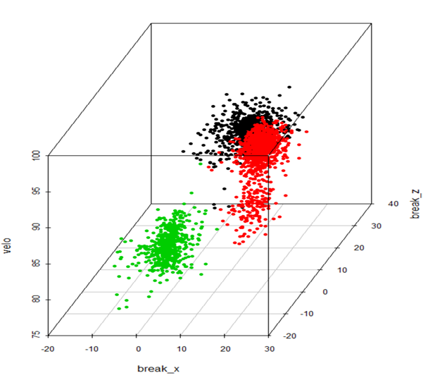
K-Means
Algorithm Pros
Simple to use, easy to interpret results
Wide spread use
Excellent for partitioning obvious clusters, such as fastball pitches
Input parameter is our desired model output
Inefficient with clustering abnormal shapes (non ellipsoid)
Good Clustering
Algorithm Cons
Poor Clustering
Notes:
1. Separate samples in n groups of equal variance
2. Minimize the inter-clustering distance

Slide 21
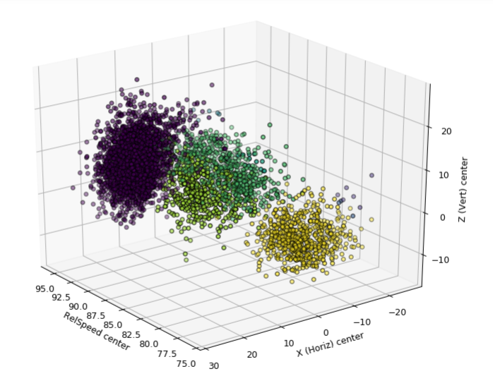
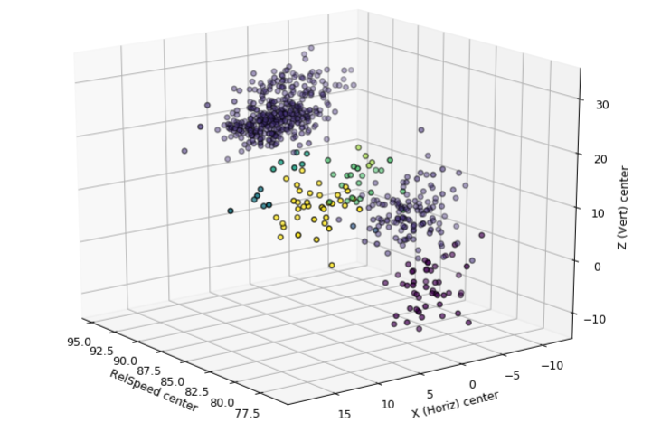
Spectral Clustering
Algorithm Pros
Three stage Hybrid algorithm
simplifies dataset into low-dimensional matrices
Finds connectivity between data points
Scores connection strength to cluster points together
Works well when there is a small number of clusters
Input parameter is our desired model output
Inefficient with abnormal shapes
Highly computational and procedural
Good Clustering
Algorithm Cons
Poor Clustering

